Slide 1
Section 1.1 Scientific Notation

Slide 2
Scientific notations can be used to represent very large numbers or very small numbers.

Slide 3
Standard Form for Scientific Notation
Scientific Notation is written in the form:
a$× {10}^{n}$where $1≤a<10$and n is an integer which can be positive or negative, depending on the number.

Slide 4
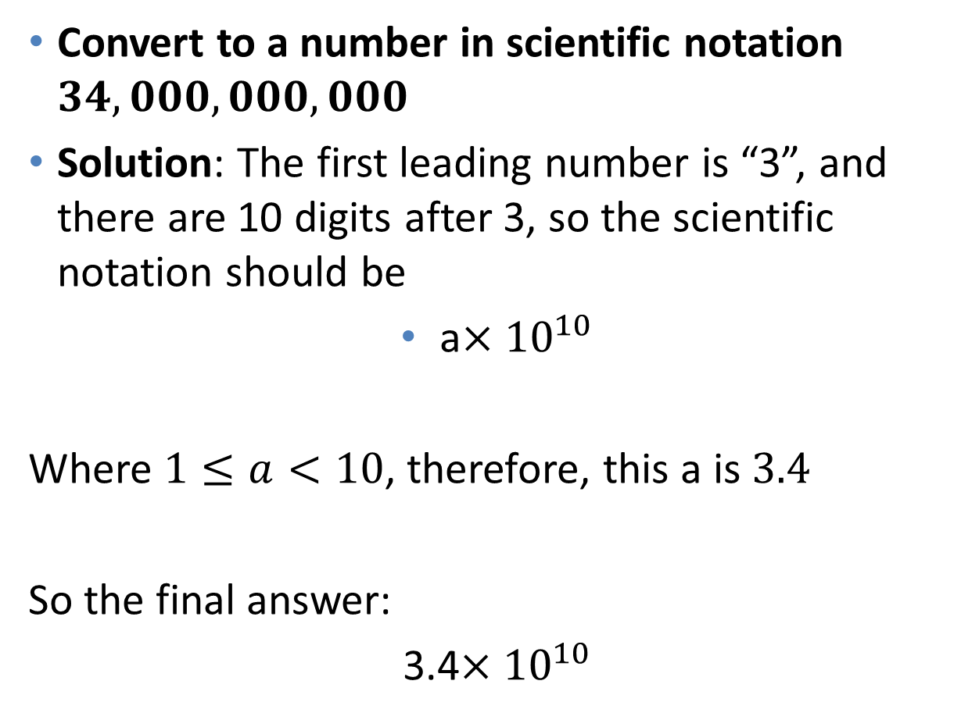
Example 1
Convert to a number in scientific notation $34,000,000,000$
Solution: The first leading number is “3”, and there are 10 digits after 3, so the scientific notation should be
a$×{10}^{10}$
Where $1≤a<10$, therefore, this a is $3.4$
So the final answer:
3.4$×{10}^{10}$

Slide 5
Example 2
Convert to a number in scientific notation $1,200,000,000$
Solution: The first leading number is “1”, and there are 9 digits after 1, so the scientific notation should be
a$×{10}^{9}$
Where $1≤a<10$, therefore, this N is $1.2$
So the final answer:
1.2$×{10}^{9}$

Slide 6
Example 3
Convert to a number in scientific notation $.00000087$
Solution: The first NONZERO number “8”, is the 7-th digit after the dot, so the power of 10 is -7
a$×{10}^{−7}$
Where $1≤a<10$, therefore, this N is $8.7$
So the final answer:
8.7$×{10}^{−7}$

Slide 7
Example 4
Convert to a number in scientific notation $.0000413$
Solution: The first NONZERO number “4”, is the 5-th digit after the dot, so the power of 10 is -5
a$×{10}^{−5}$
Where $1≤a<10$, therefore, this N is $4.13$
So the final answer:
4.13$×{10}^{−5}$

Slide 8
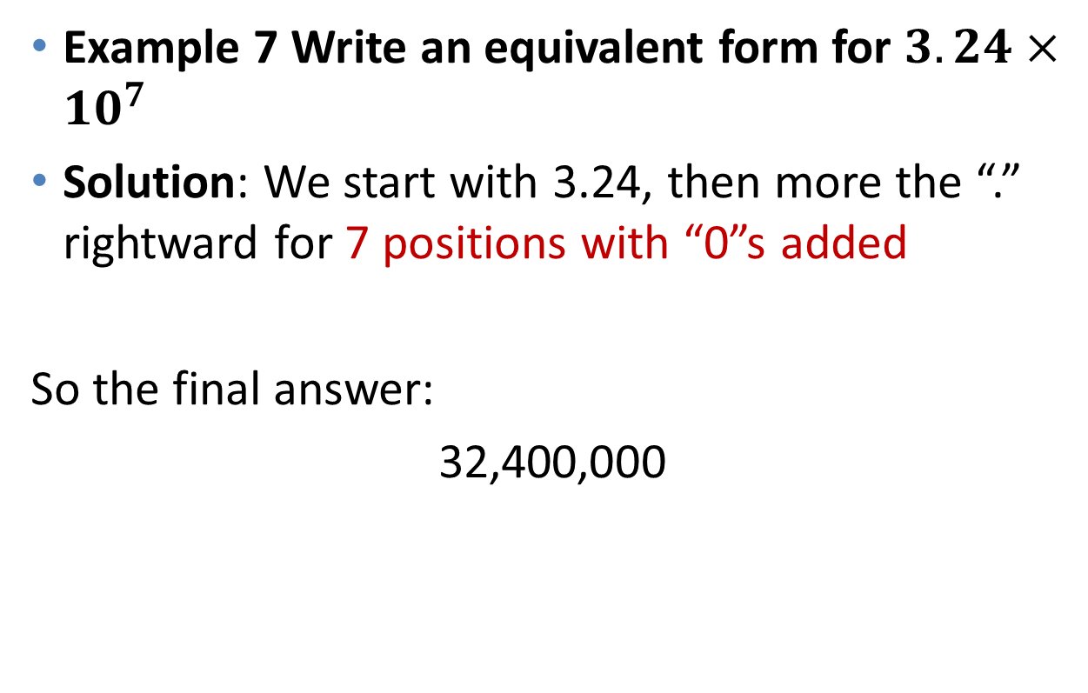
Convert numbers in Scientific Notations to Decimals
Example 7 Write an equivalent form for $3.24×{10}^{7}$
Solution: We start with 3.24, then more the “.” rightward for 7 positions with “0”s added
So the final answer:
32,400,000
7 digits

Slide 9
Convert numbers in Scientific Notations to Decimals
Example 8 Write an equivalent form for 1$.65×{10}^{−5}$
Solution: We start with 1.65, then more the “.” leftward for 5 positions with “0”s added
So the final answer:
0.0000165
5 digits

Slide 10
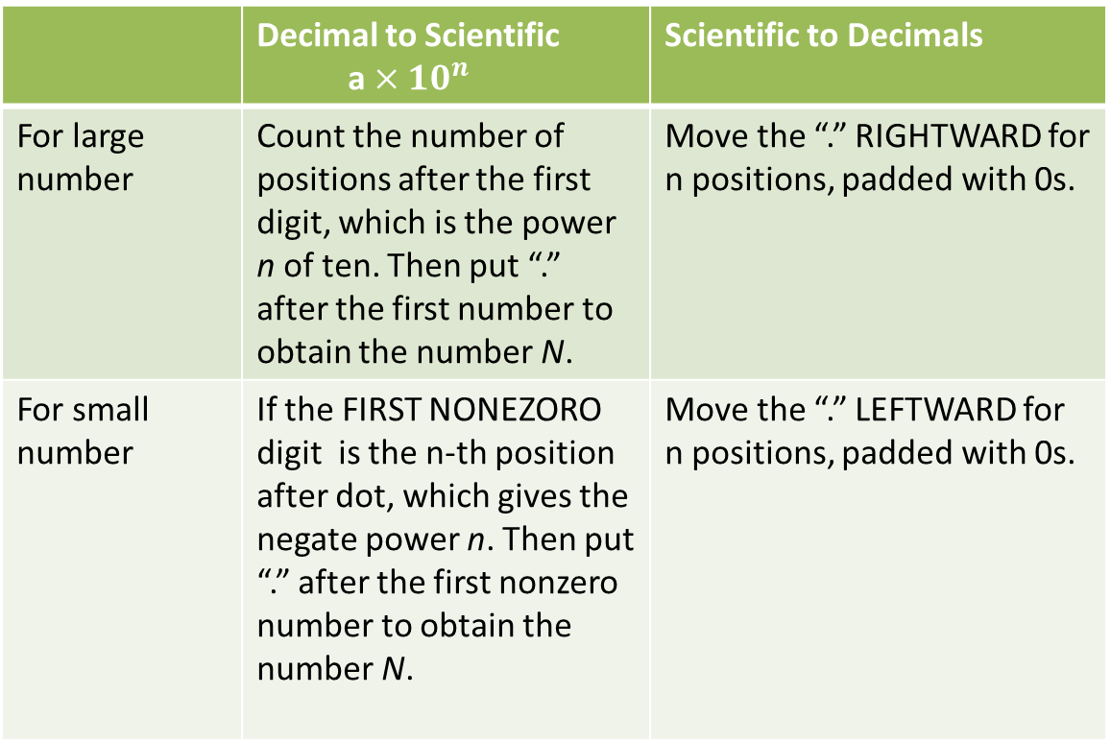
Summary
 | Decimal to Scientific a $×{10}^{n}$ | Scientific to Decimals
For large number | Count the number of positions after the first digit, which is the power n of ten. Then put “.” after the first number to obtain the number N. | Move the “.” RIGHTWARD for n positions, padded with 0s.
For small number | If the FIRST NONEZORO digit is the n-th position after dot, which gives the negate power n. Then put “.” after the first nonzero number to obtain the number N. | Move the “.” LEFTWARD for n positions, padded with 0s.

Slide 11
Example 5
Put “<”, ”>”, and “=“ in each of the following blank:
a. 43,000______ $4×{10}^{5}$
b. $2.85×{10}^{4}___________$ 28,400
c. $4.27×{10}^{5}___________$ 427,000
43000__<____ $4×{10}^{5}$ .
We converted
$4×{10}^{5}$=400,000, which is obviously bigger than 43,000. So we have the same answer.

Slide 12
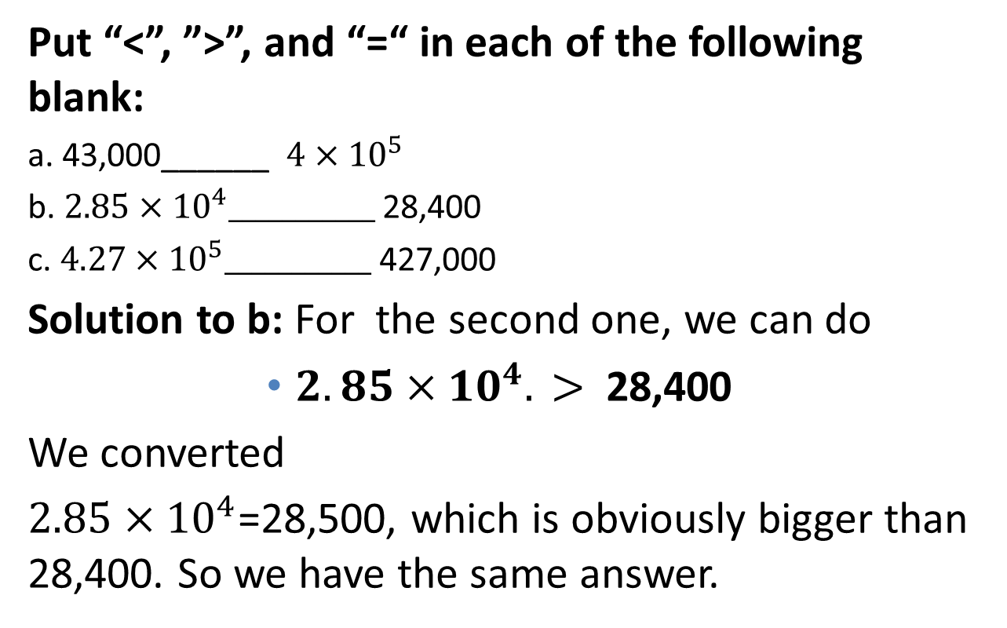
Example 6
Put “<”, ”>”, and “=“ in each of the following blank:
a. 43,000______ $4×{10}^{5}$
b. $2.85×{10}^{4}___________$ 28,400
c. $4.27×{10}^{5}___________$ 427,000
Solution to b: For the second one, we can do
$2.85×{10}^{4}. >$ 28,400
We converted
$2.85×{10}^{4}$=28,500, which is obviously bigger than 28,400. So we have the same answer.

Slide 13
Example 7
Put “<”, ”>”, and “=“ in each of the following blank:
a. 43,000______ $4×{10}^{5}$
b$. 2.85×{10}^{4}___________$ 28,400
c. $4.27×{10}^{5}___________$ 427,000
We converted
$4.27×{10}^{5}$= 427,000, which gives us the same answer.

Slide 14
Example 8
Put the following numbers from least to greatest
0.005, $5×{10}^{−5}, 0.000006, 6.23×{10}^{−3}, 0.001, 0.0000011$
Solution: we will convert all numbers into decimal, then compare!
0.005= $0.005$, $\left(2\right) 0.000006$= 0.000006
(3) $0.001=$ $0.001$ (4) $0.0000011$=$0.0000011$
(5) $5×{10}^{−5}$ = 0.00005 (6) $6.23×{10}^{−3}$= 0.00623
To do the comparison, we choose the value with the most number of decimals after the zero.

Slide 15
Solution to Example 8 (continued)
Solution of Values from Least to Greatest:
$0.0000011$, $0.000006$, $0.00005$, 0.001, 0.005, $0.00623$

